Slide 1
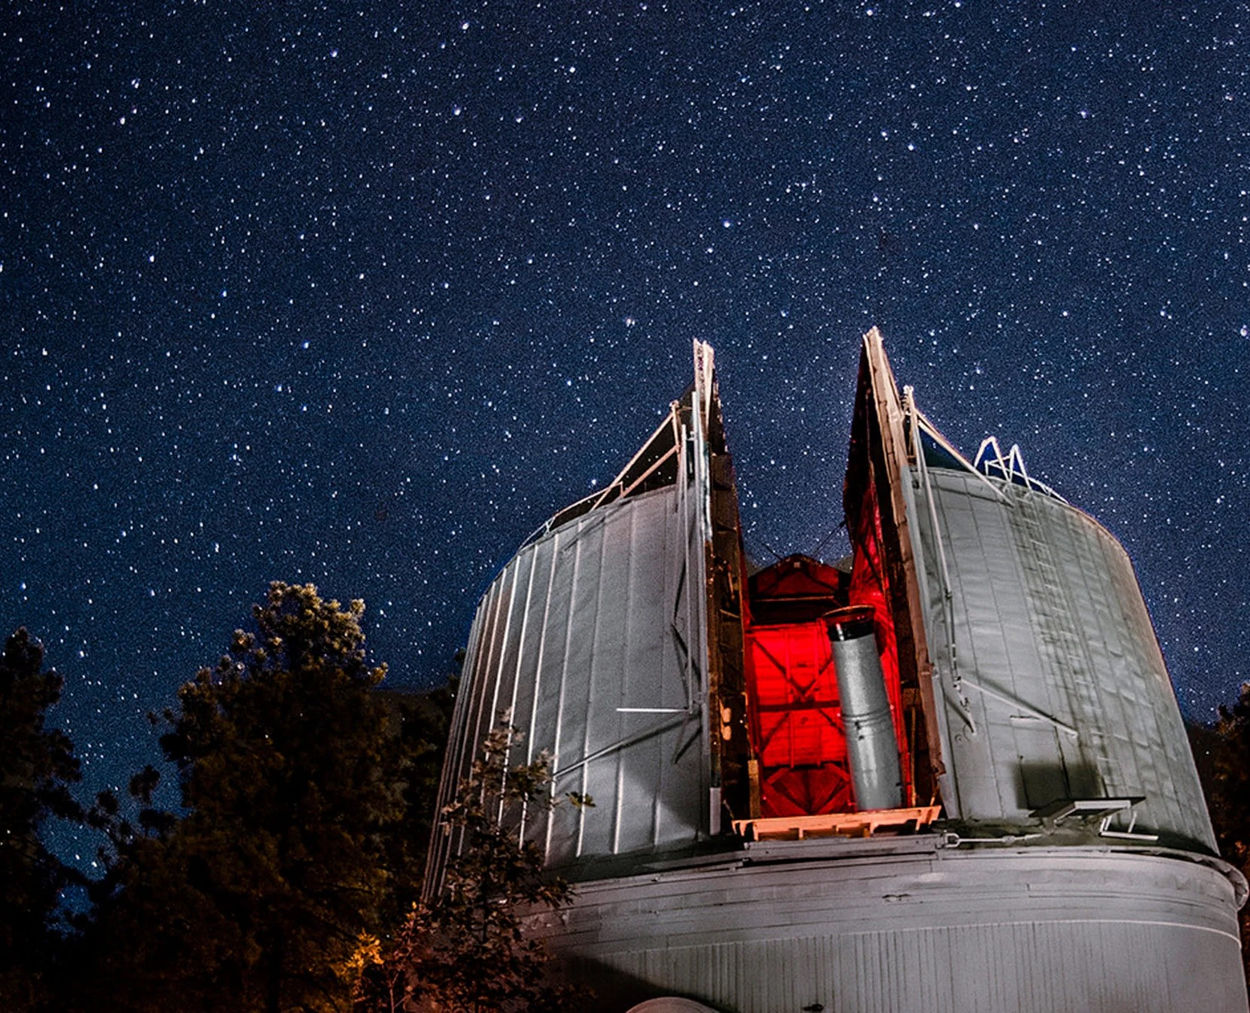

Exploring the Properties of Centaurs
NASA SPACE GRANT
Saturday, APRIL 22nd, 2023
Space Grant Statewide Symposium
Tessa Richardson
Northern Az University
Dr. Theodore Kareta
Lowell Observatory
Astronomy
Multipurpose Template

Slide 2
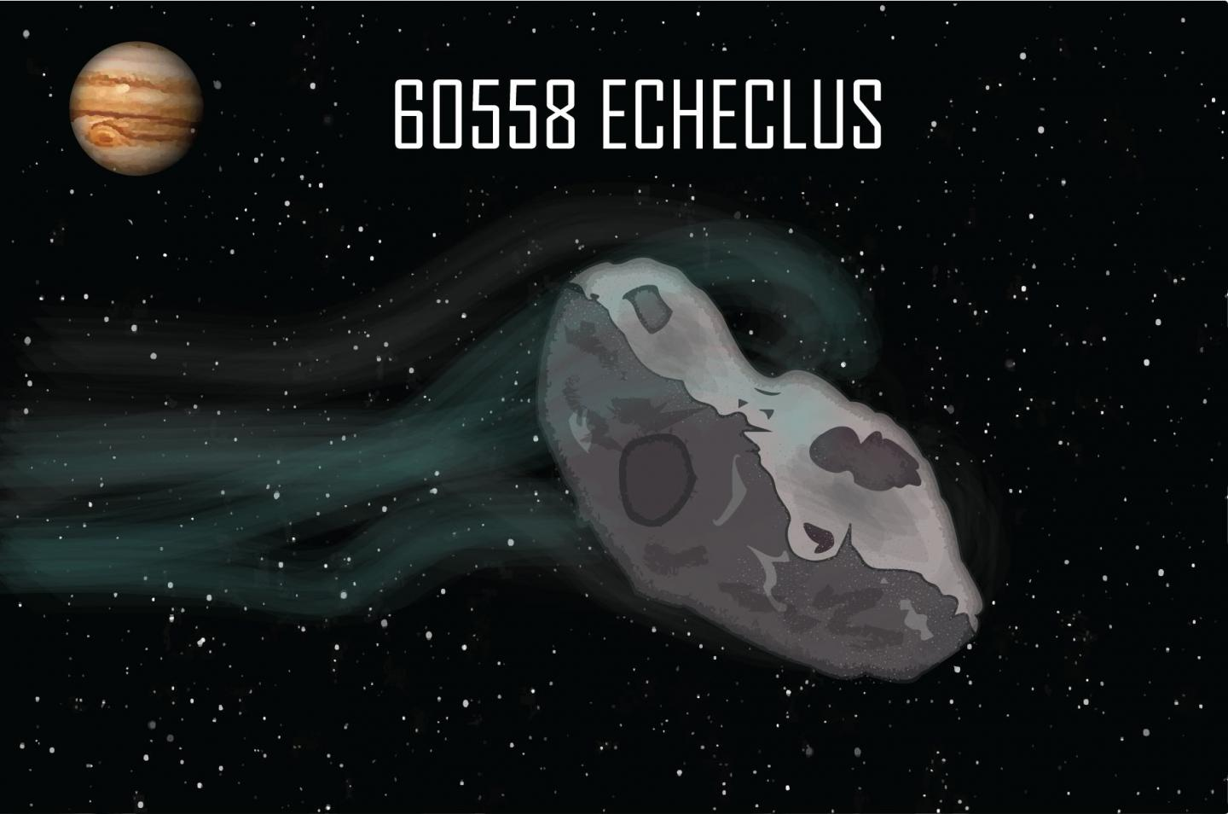

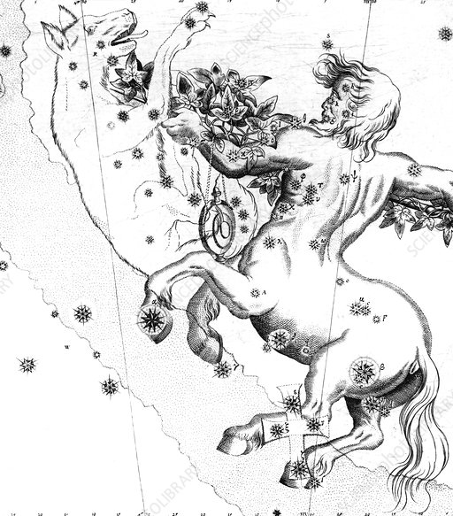
So who is Echeclus?
A Centaur!
In Greek Mythology Centaurs are half-human half-horse, In the Solar System Centaurs are half-comet, half-asteroid.
Centaurs are a class of small Solar System Objects that have orbits which cross those of the Giant Planets.
Echeclus experiences outbursts (periods of activity) which are not correlated with distance to the Sun.

Slide 3
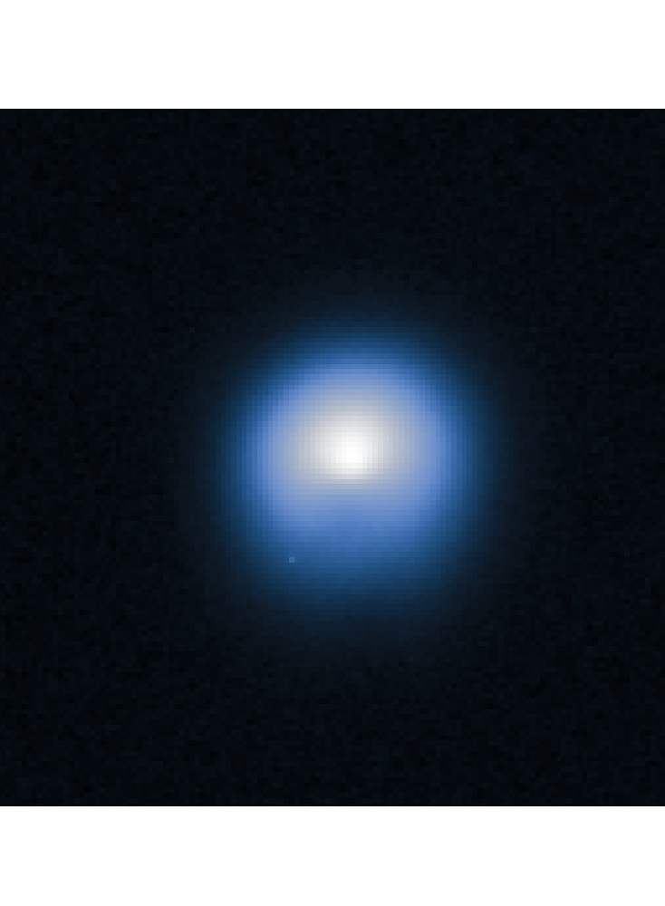
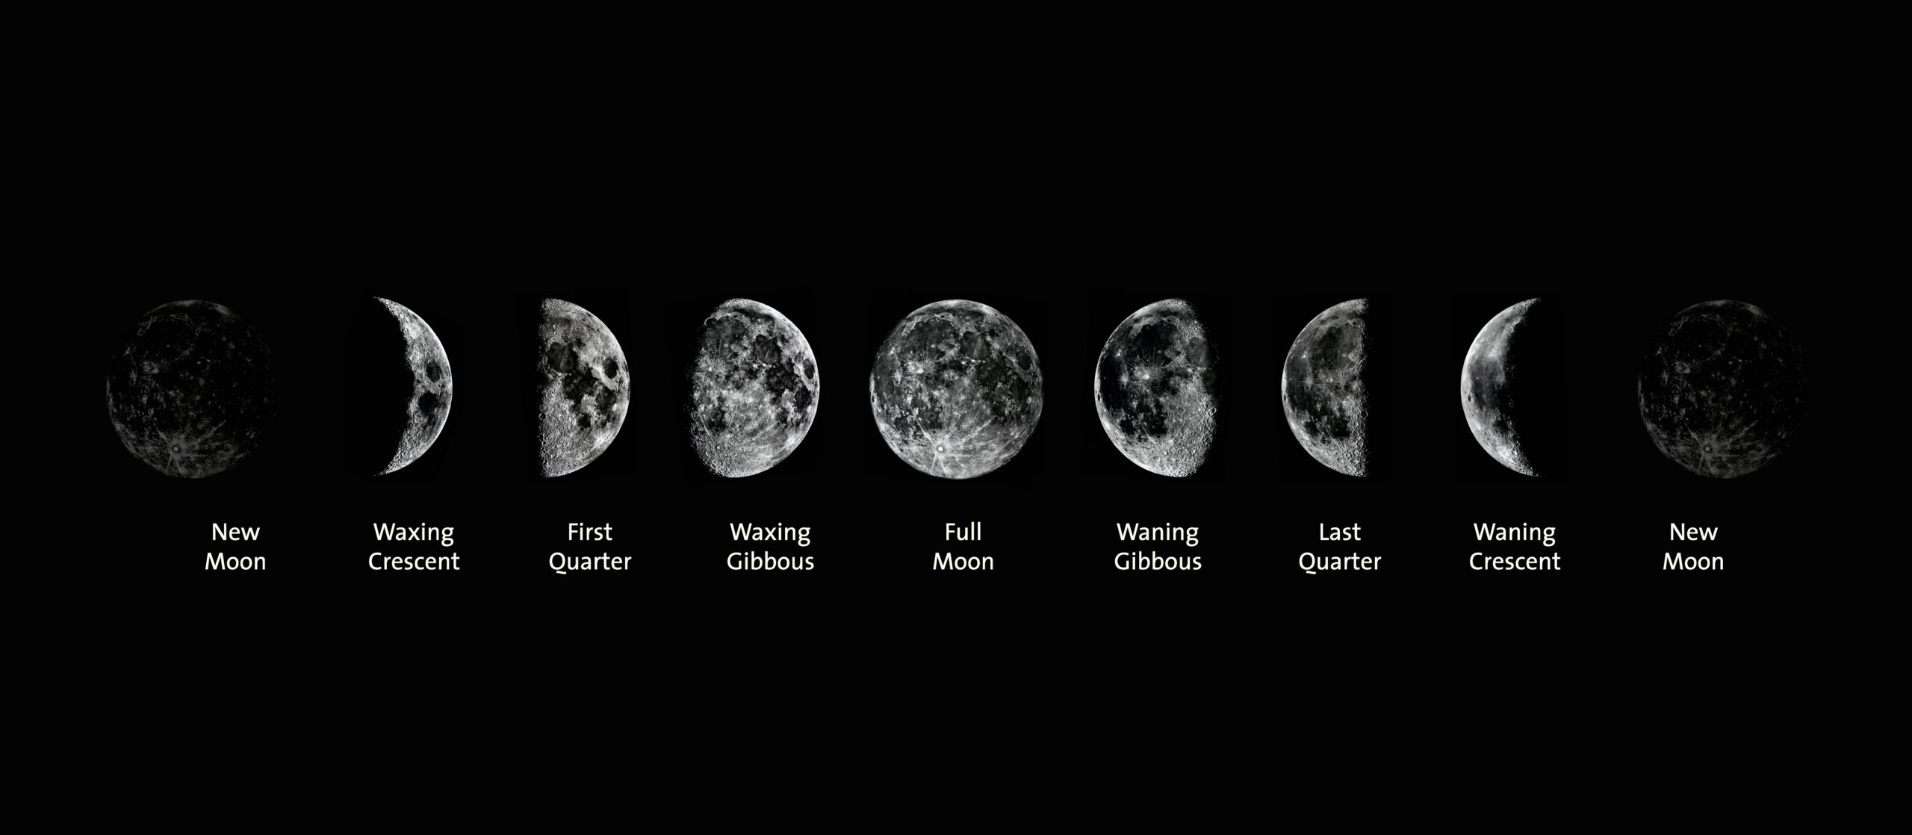
Brightness of Objects in Planetary Science vs Astronomy
K A R E T A E T. A L., 2 0 1 9
For a Solar System object, the absolute magnitude is a measure of the brightness an object would have if it were at 1 AU from both the observer and the Sun, and at a phase angle (the Sun-object-Earth angle) of 0 degrees.
For example the Phase Angle of the moon is zero when the moon is full. The Phase Curve of a solar system body refers to the brightness (absolute magnitude) of the object as a function of the object’s phase angle.

Slide 4
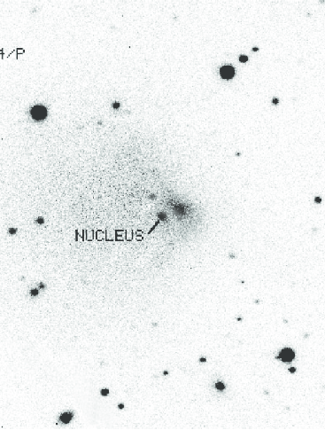
The brightness (phase curve) of the dust surrounding Echeclus is likely different from the phase curve of the nucleus.
T E G L E R E T. A L., 2 0 0 8
So why is information about the phase curve useful? The phase is a measure of how the object dims with increasing phase angle. The phase curve has implications for characterizing an object’s surface texture and composition. Craggy or rough bodies reflect light different from smooth ones. We are studying the Phase Curve of Echeclus to understand how much light comes from the surrounding dust vs the nucleus.

Slide 5
RESEARCH OUTLINE
Query the Orbit Fit
Phase Curve
Echeclus
Figure out how far Echeclus was from the Sun and the Earth during each of the ATLAS observations.
Compare models of how bright Echeclus *should* be against ATLAS observations, try different clipping and fitting techniques.
Goal: to begin to understand this Centaur’s unusual properties and composition.
Big Data
Functions
Results
Gather photometric (brightness) observations from the ATLAS Survey.
Creating code to model the Absolute Magnitude WRT Time , Phase Angle.
Compare retrieved phase curve against phase curves for other similar objects, like comets.

Slide 6
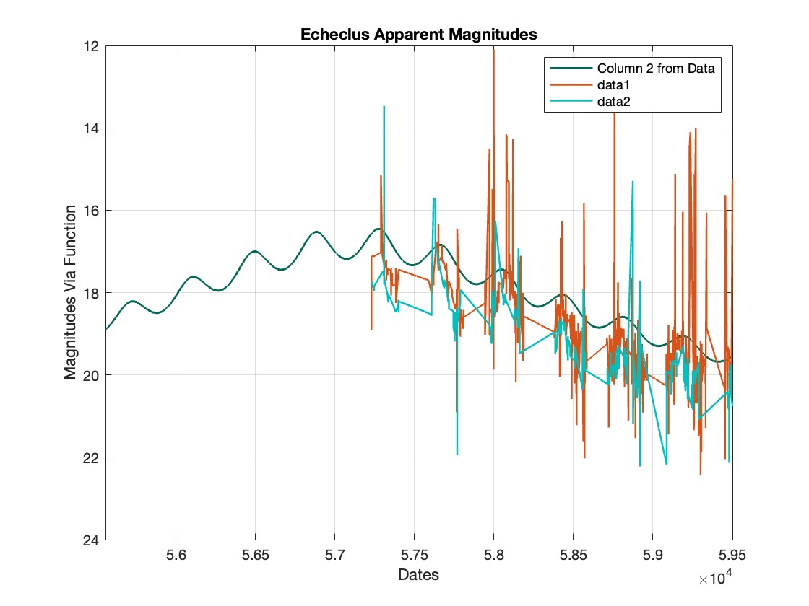
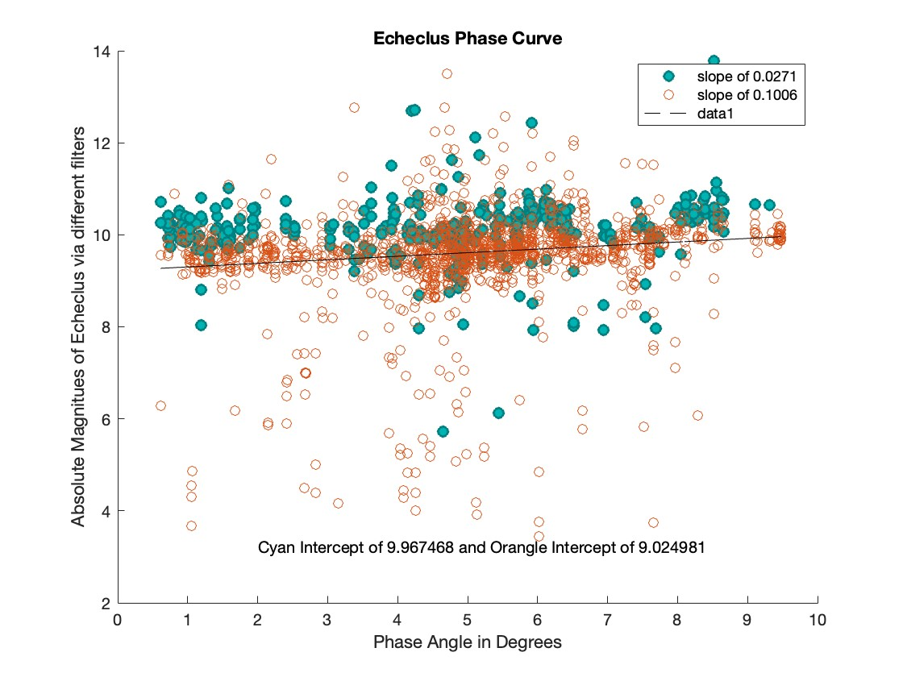
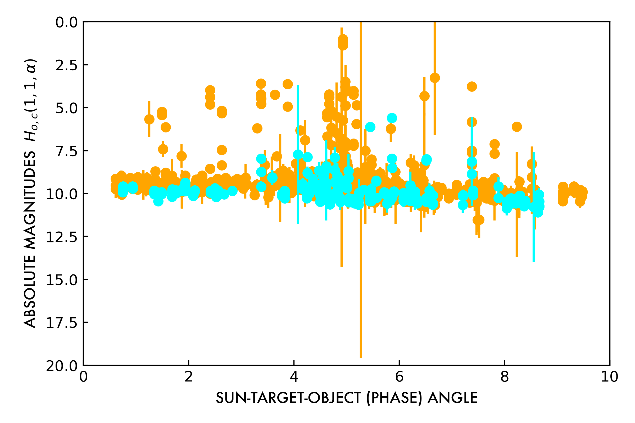
Due to the unpredictable nature of Echeclus, trimming the data around outbursts was necessary to obtain accurate measurements. Several methods were used to ensure the reliability of the Data from least-squares to Markov Chain Monte Carlo.
Crunching the Data
Comparison of Graphs created in with Matlab and Python with unique codes resulting in similar magnitude and phase curve measurements for Echeclus.

Slide 7
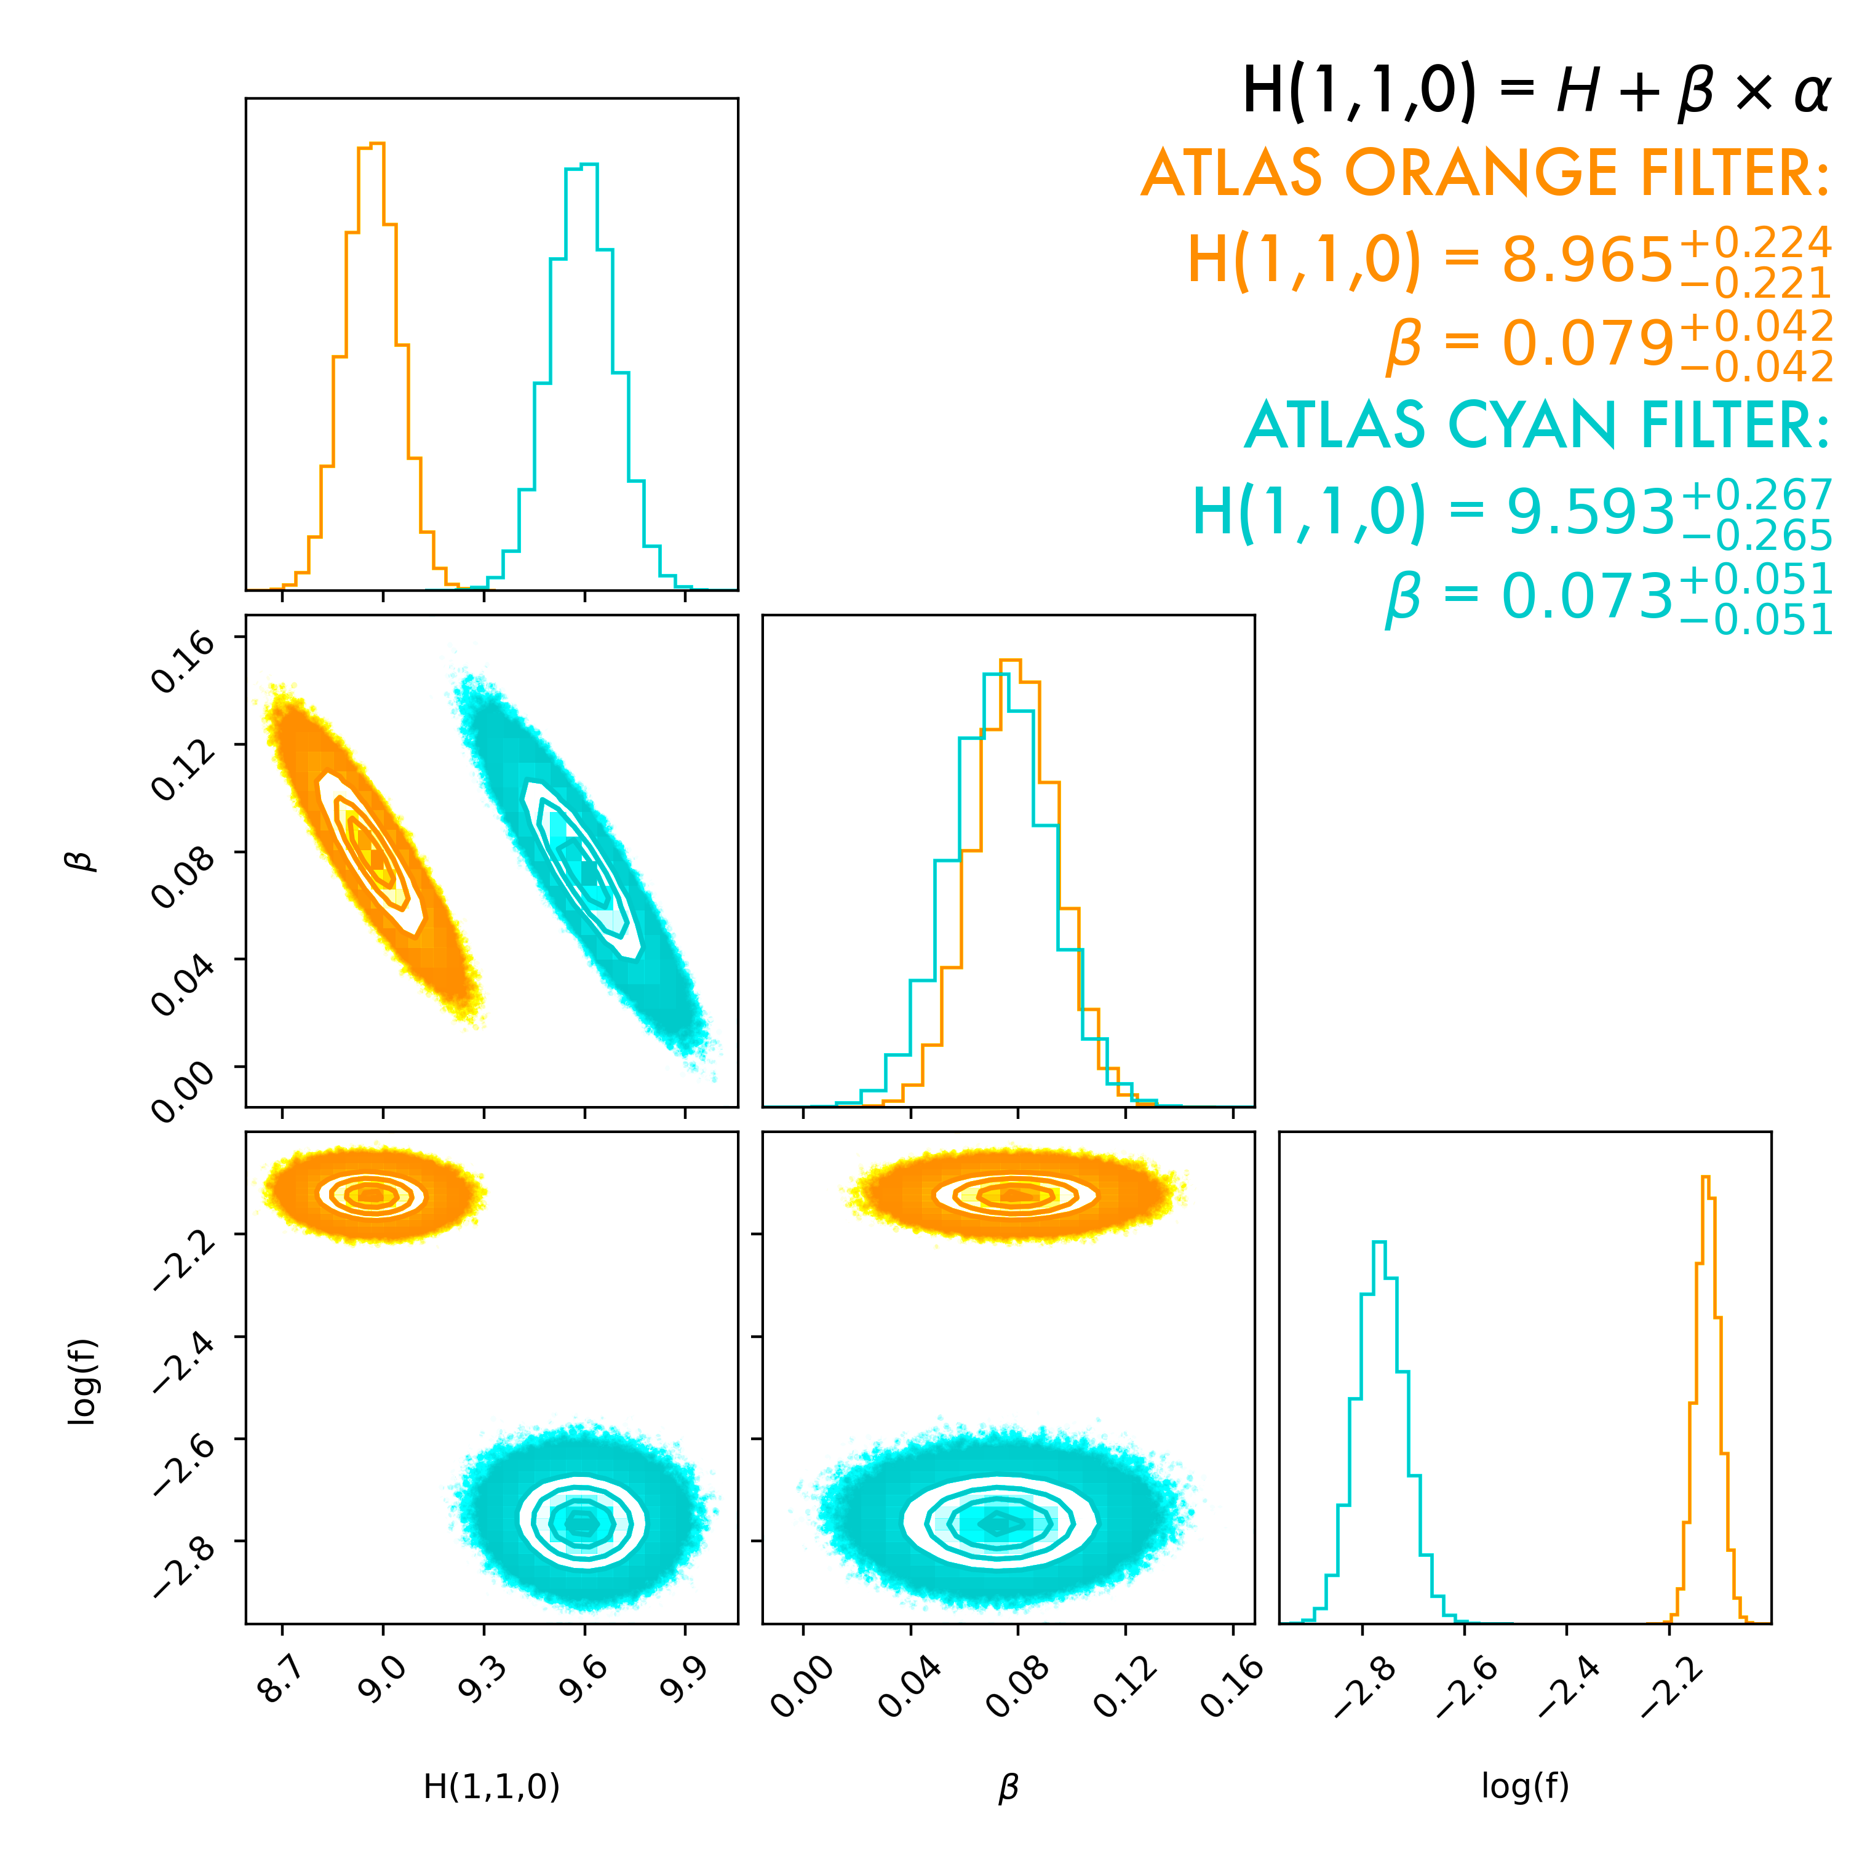
Results:
Echeclus has a Steep Phase Curve
The Phase Curve of Echeclus is higher than expected even when controlling for significant activity, outbursts and taking filters into consideration.
Phase Curve Increases with Surface Texture. Echeclus may have a highly uneven or varied composition, though other explanations are possible.

Slide 8
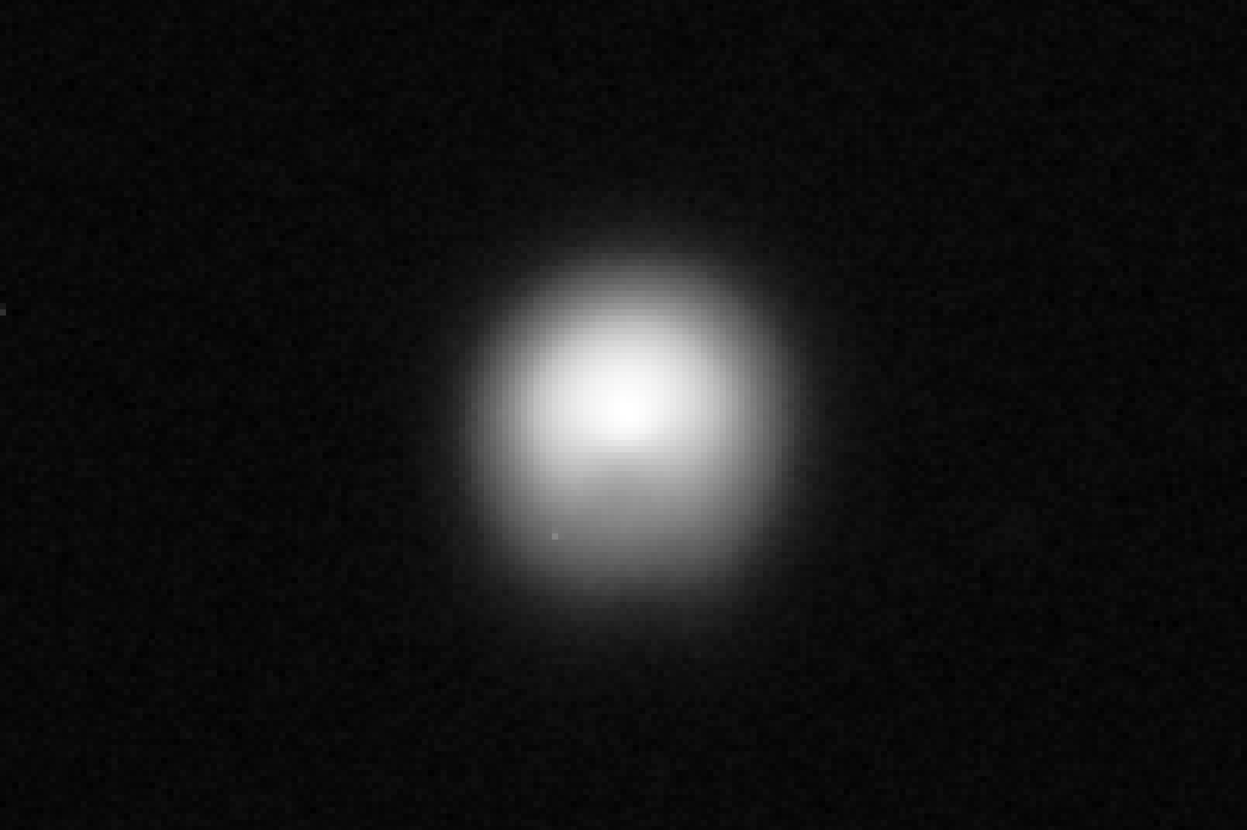
The Phase Curve of Echeclus is very different than the phase curves of most other solar system comets.
These results are consistent with another recently published paper which did not focus on, but did mention Echeclus.
Information about the surface and composition of Echeclus is needed to help understand the periods of high activity this Centaur exhibits. These active periods are not well understood and are areas of active research!
K A R E T A E T. A L., 2 0 1 9

Slide 9
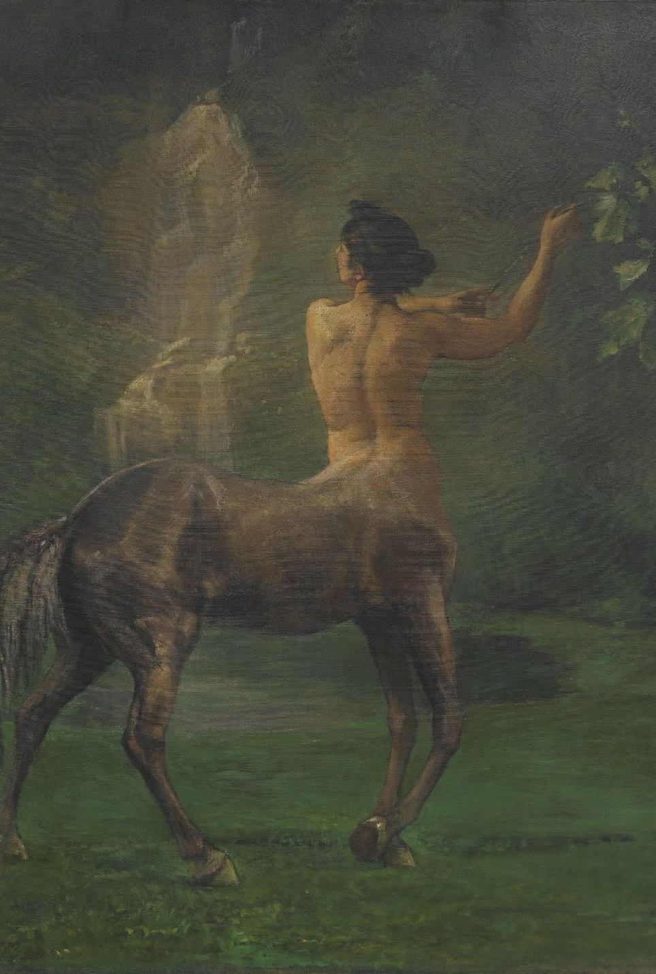
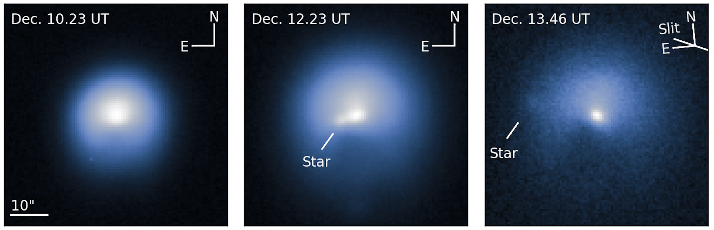
EHCECLUS!
ALL HAIL THE LORD OF THE CENTAURS
W W W . L O W E L L . E D U
This unexpected phase curve measurement of Echeclus provides motivation for further research using additional data sources such as PANSTARS. Dr. Kareta and Tessa will continue to explore the properties of Echeclus over summer 2023!
K A R E T A E T. A L., 2 0 1 9

Slide 10
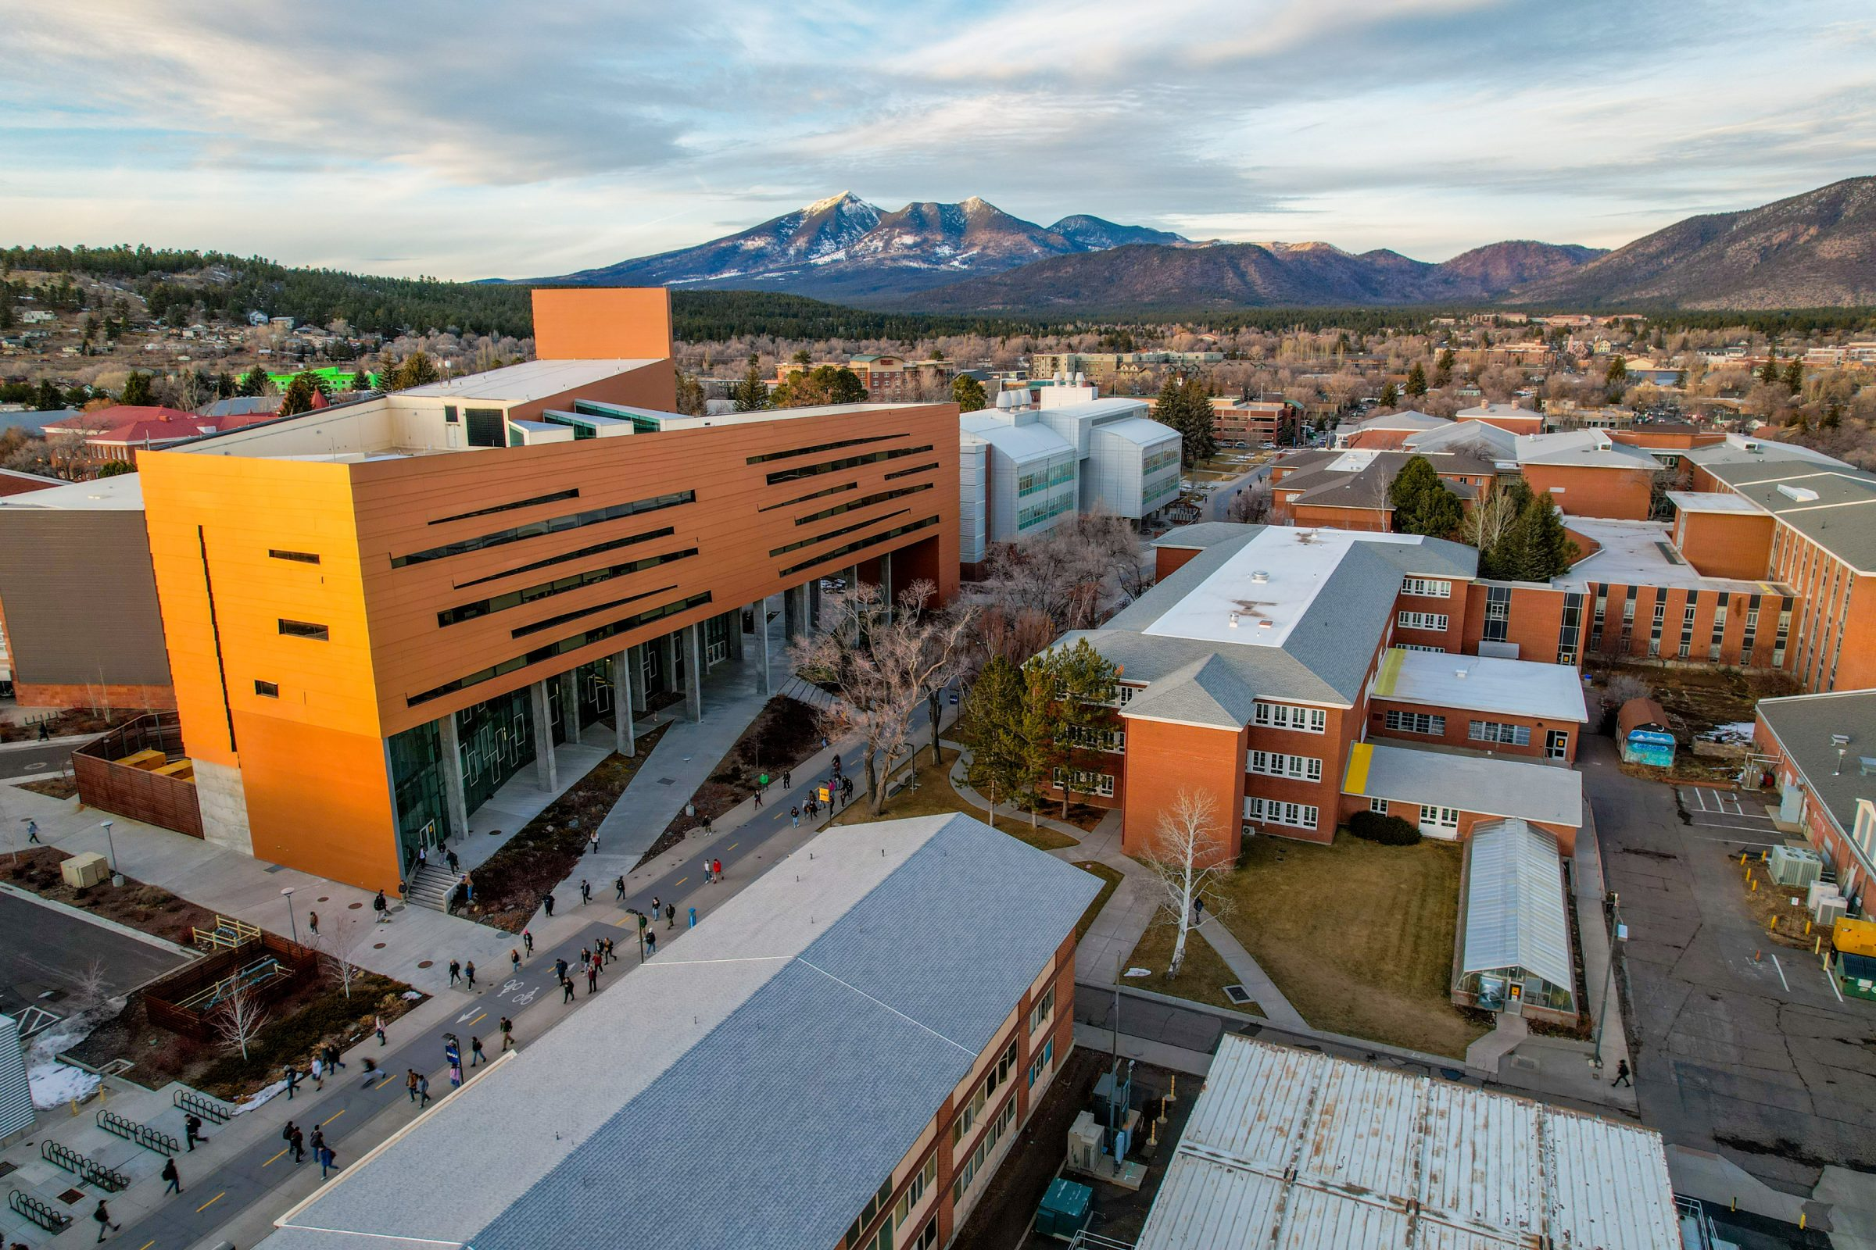
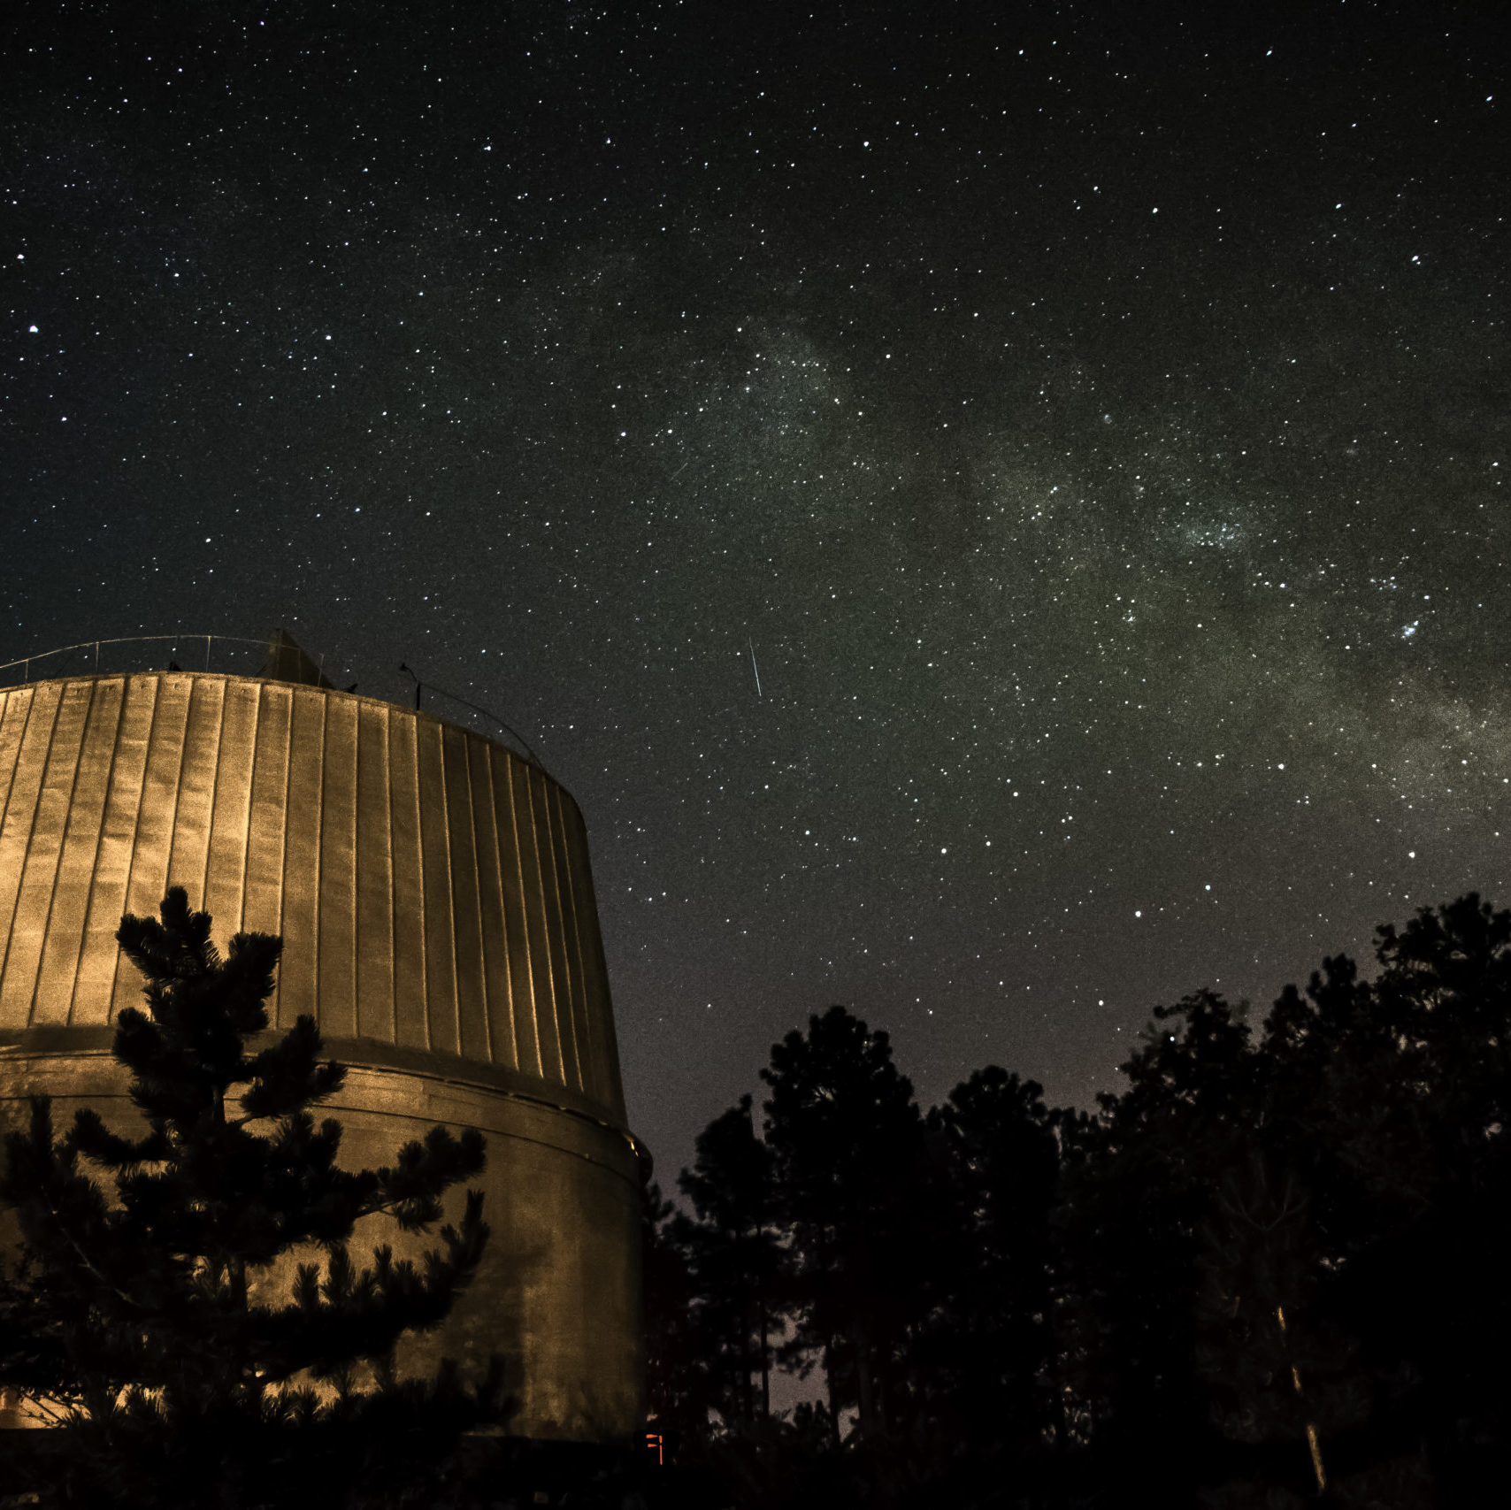
THANKS
I would also like to thank COFFEE without whom this and many other things would not be possible.
FOR WATCHING
W W W . L O W E L L . E D U
Thanks very much to the organizers of AZSGC!
Thanks to ASU for hosting
I’d love to meet you!
Thank you to my wonderful ever patient advisor Dr. Kareta!

Slide 11
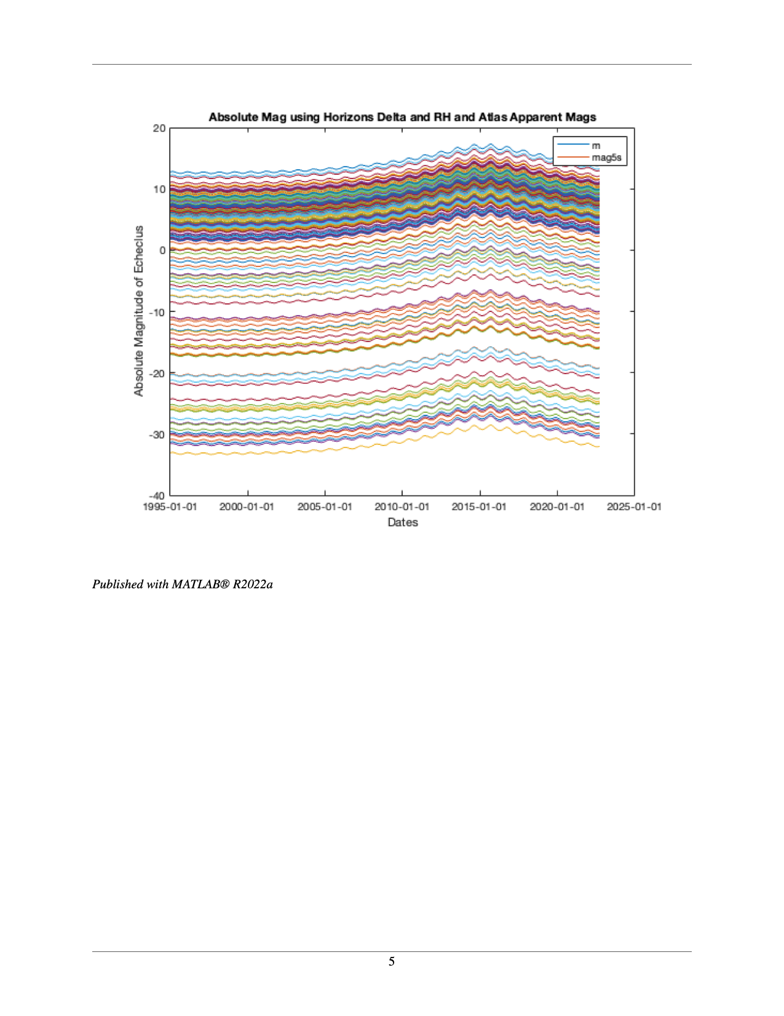
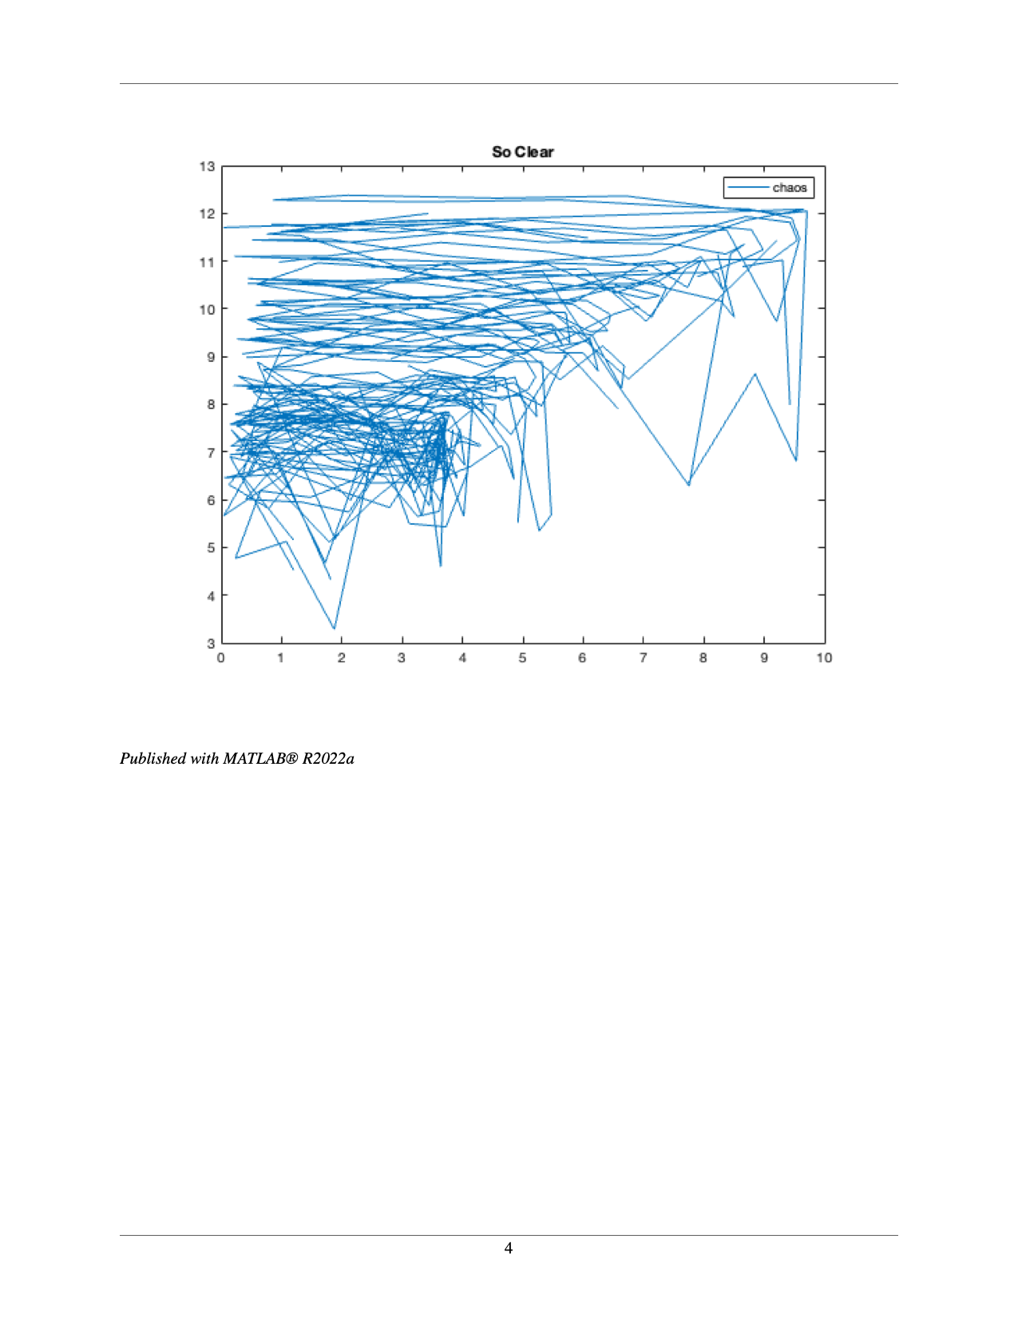
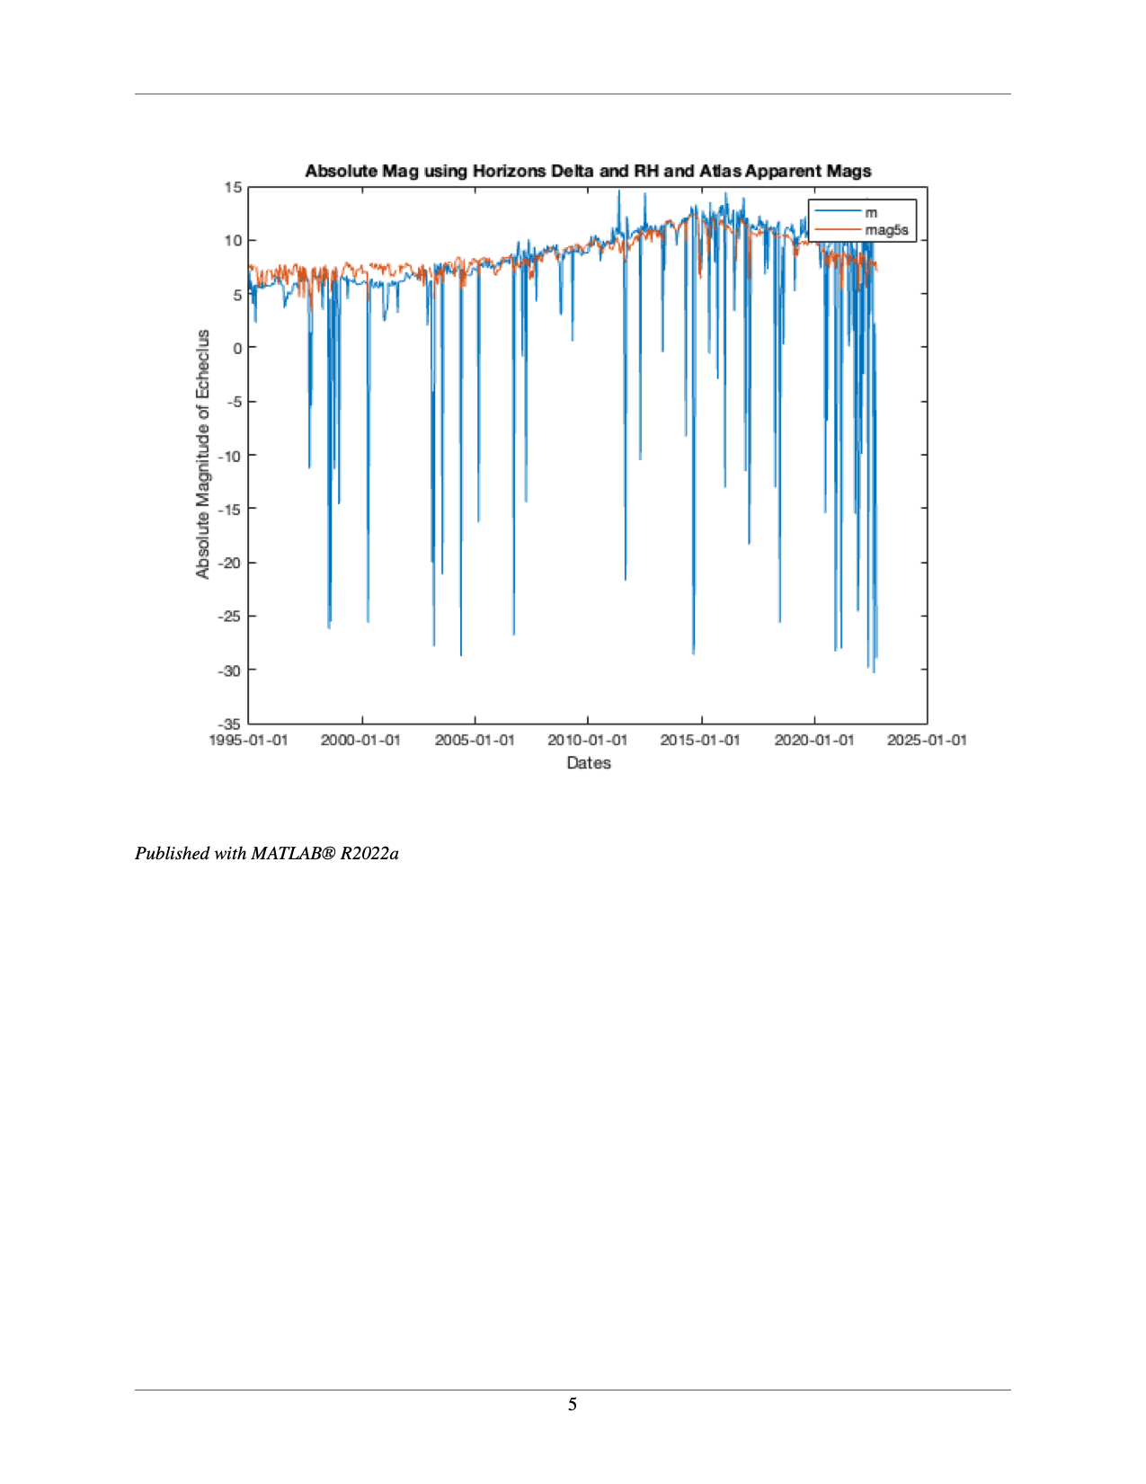
OUTTAKES
*TESSA TRIES TO CODE

